Slide 1
Religion in Norway: Norwegian Life and Society
Lars Laird Eriksen
Social science dept– Norwegian School of Theology

Slide 2
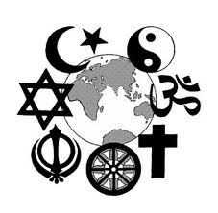
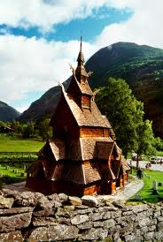
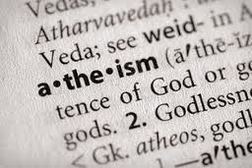
From one religion…
…towards many religions?
… or no religion?

Slide 3
An overview of this lecture
Part one:
- A quick history
- The legal situation: changing the constitution
Part two:
- Religion amongst young Norwegians today
A story from my fieldwork on religious education in Norwegian school.
Secular?
Cool?
Identity?

Slide 4
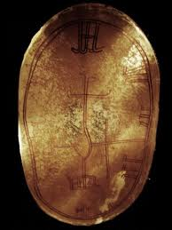
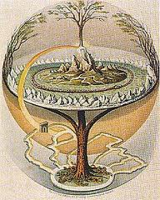
A quick history
Pre-Christian Sami religion – BC 8000
Pre-Christian Norse religion AD 500 - 1000
Even this early, there was plenty of cultural communications between Sami and germanic cultures.

Slide 5
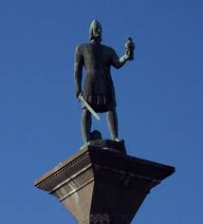
Christianity enters the scene:
Scandinavia not isolated – a culturally complex time!
Christianity slowly spreads from about 950.
Traditionally connected to King Olav Haraldsson (St. Olav) -
Political consolidation or religious change?

Slide 6
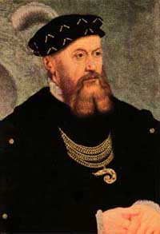
Reformation
In 1537 Christian the 3rd was King of Denmark and Norway.
A political move as well as religious.
He became convinced by
Martin Luther, and left the
Catholic Church.
A Lutheran
state church is established!
The institutions needed to connect Norwegianness and religion established!

Slide 7
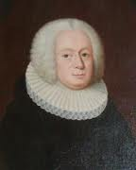
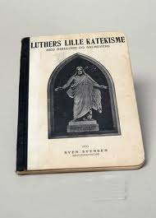
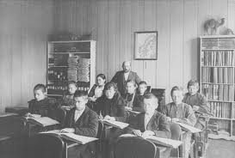
Pietism – enforced by the state
State pietism
1736: compulsory confirmation
1739: School for all!
A mix of control and good intentions.
Religion a tool for shaping the population
Providing shared experiences

Slide 8
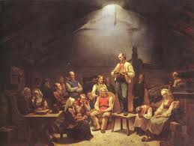
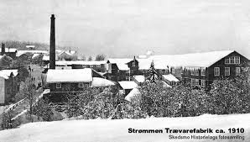
Pietism – Challenges the state
Hans Nielsen Hauge
Preacher and writer (1771 - 1824).
Anti-Clergy
Religion a tool for expressing discontent againt foreign rule

Slide 9
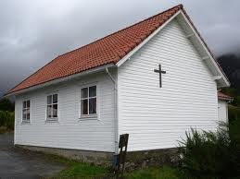
Modes of religious life in the 20thC
Religious ”counter-culture” with prayer houses
Rural
Hard-working ”protestant capitalist ethic”
South and west coast
Emphasis on personal faith
Politically conservative

Slide 10
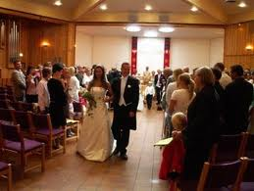
Modes of religious life in the 20th Century
The «folkekirke» – or the people’s church
Life rites: Christening, Confirmation, Weddings, Funeral
CofN Church buildings often local hub
More liberal ethics
Eastern, middle and Northern Norway

Slide 11
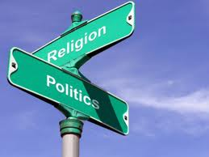
Modes of non-religious life in the 20th century: secularisation
Norway part of broader European trend – enlightenment philosophy
Religion and labour movement : From hostile to ambivalent relationship
Strong secular humanist movement
Norway is low on religious participation, slightly higher on self-identification

Slide 12
Sami Religion today
Læstadianism
Swedish pastor Lars Levi Læstadius engaged with the Sami populations in Norway, Sweden and Finland
A pietist, anti-authority movement – establishing an indigenous Sami Christianity.
Countering colonialist missionary activity
Still an influence – an ascetic counter-culture

Slide 13
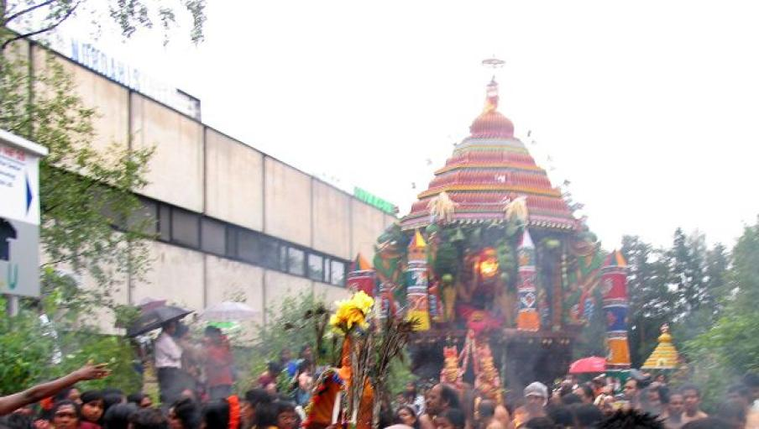
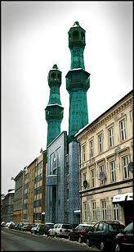
Immigration and pluralisation
From about 1960, labour migration to Norway.
Islam
Hinduism
Buddhism
Christian denominations (Catholic and pentacostal)
Changes in school
Changes in State-Church relations
Place of Islam in public life a huge issue

Slide 14
Membership in religious organisations outside the CoN
 | 1991 | 2011
Islam | 19 000 | 106 735
Judaism | 1045 | 819
Hinduism |  | 5 858
Buddhism |  | 14 580
Christian outside CoN |  | 266 834
Life-View org | 49 400 | 84 481
http://www.ssb.no/english/subjects/07/02/10/trosamf_en/tab-2011-12-06-01-en.html

Slide 15
The constitution: State & Church
Established Church.
Part of administration, not seperate legal entity
Government appoints bishops
50% of the government must be members of CofN.
King the head of Church
Financed through govt budgets – other faith organisations compensated with equivalent sum.
This will change in 2012. Decision to be made May 21st

Slide 16
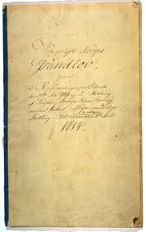
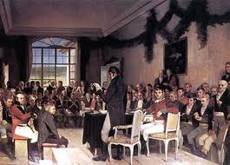
The present Article 2:
All inhabitants of the Realm shall have the right to free exercise of their religion.
The Evangelical-Lutheran religion shall remain the official religion of the State. The inhabitants professing it are bound to bring up their children in the same

Slide 17
A new article 2:
The foundational values remain our Christian and Humanist heritage. This constitution shall secure democracy, rule of law and human rights.
What does ”foundational values” mean? Are heritages and values the same? Are ”christian” and ”humanist” heritages compatible or at odds?

Slide 18
What do the new changes add up to?
Greater liberty for the Church of Norway - ending Government influence on Church matters (especially appointing Bishops)
Ending the formal connections between the Church of Norway and structures of governance
Retaining (even strengthening) the symbolic importance of a Christian heritage for a Norwegian identity
Retaining a symbolically priviliged position for the Church of Norway

Slide 19
PART TWO – Religious information control
Join me in meeting the ninth grade in south-east Oslo
I met over 400 kids
3 self-identified as Christian
Surprisingly few considering
Norwegian history
public debate
statistics of membership in religious organisations

Slide 20
Christians in the closet?
Why did so few kids call themselves Christian?
A sociological (not a moral!) inquiry.
Four tentative explanations:
Secularisation?
Pluralism - Christianity not PC?
Not cool?
Identity - Religion and Norwegianness

Slide 21
Secularization
”Religion 1991 - 2008” Part of an international survey.
Strongly believes:
1991: 20%
2008: 15%
Does not believe
1991: 10%
2008: 18%
2008:
No Belief | Prob. No bel | Higher force | Believe/doubt | Believe
18 | 14 | 24 | 29 | 15

Slide 22
Secularization: Participation in religious services
Monthly or more
1991: 11%
2008: 7%
Never
1991: 35
2008: 43
2008:
Monthly + | Several times a yr | More rarely | Never
7% | 8% | 42% | 43%

Slide 23
Secularization: Self-identification
Strongly religious
1991: 10%
2008: 7%
Strongly non-religious
1991: 13%
2008: 22%
Strongly non-rel | A bit non-rel | Neither rel or non-rel/ don’t know | A bit rel | Strongly rel
22% | 7% | 37% | 28% | 7%

Slide 24
Secularization
YUPP! Check!
But not enough to explain my finding!
Secularization theory has been countered worldwide, but seems to hold for Norway.

Slide 25
Pluralisation - Membership
 | Church of Norway | Other faith organisation | No faith org.
1980 | 87.8 | 3,8 | 3,2
1999 | 86.2 | 7.6 | 6.2
2006 | 83.5 | 8.3 | 8.2
2009 | 80.7 | 9 | 10.3

Slide 26
Pluralisation - which organisations?
 | 1991 | 2011
Islam | 19 000 | 106 735
Judaism | 1045 | 819
Hinduism |  | 5 858
Buddhism |  | 14 580
Christian outside CoN | 26 600 | 266 834
Life-View org | 49 400 | 84 481

Slide 27
Pluralism
YES - Norway has become more plural
More people active in a more organisations
These organisations are cover a wider scope of religious difference.
Greater acceptance of religion?
Greater controversy around religion?

Slide 28
Religious discrimination
Marie von der Lippe:
There are two things going on in terms of Islam:
Tolerance in everyday interaction
Criticism and debate – sometimes discriminatory attacks – in public sphere
Issues concerning religion
Education
Religious covering

Slide 29
Not cool to be a believer?
A ”majority misunderstanding”?
Norwegian protestantism high emphasis on personal faith - a barrier for self-identification?
Shame?
Privatisation of religion?
”Proud muslims make it easier for everyone to be open about their faith” - says teacher. I didn’t see it.
”Christian values” often mentioned in public debate

Slide 30
Identity
I mentioned the three who called themselves Christian?
All connected to a ”pseudo-ethnicity”
Maybe this is the case with non-christian religions?
Maybe kids easily claim a religious identity when it is framed as group belonging, not personal statement?

Slide 31
The ”whiteness” theory:
Majority background Norwegians walk ”unmarked” in society.
They have the privilege of controlling when their religious identity is relevant.
Religion as FAITH privatised
Religion as IDENTITY public
The ”religionization of identity”

